Slide 2

Linux Foundation LF AI & Data Open Voice Interoperability Initiative: Building Chatbots that talk to each other with the Open Voice Sandbox
Leah Barnes, Emmett Coin, Deborah Dahl
October 4, 2024

Slide 3

Collaboration among Intelligent Assistants
There are millions of chatbots and voice bots (conversational assistants) in the world
Hosted on mobile phones, smart speakers and websites
Hosted by many organizations – government, business, and non-profit
Each one is independent of the others, even within an organization
Each one has its own expertise
This leads to:
implementation complexity
duplication of effort
friction for users

Slide 4





Local store
Drugstore chain
Drug information site
IoT devices, Lights, cameras, HVAC
My prescriptions
Robot pets
Public robots (stores, airports, museum)
Interoperable Intelligent Conversational Assistants
Notes:
Personal robot, for example for eldercare. With AI natural language interface users are already a long way toward knowing how to control the device

Slide 5

Our Specifications
Open source
Dynamic, real-time configurations of AIs
Standard messages
Few assumptions about assistant architecture and capabilities
Resources: implementation sandbox and specs in our GitHub repositories https://github.com/open-voice-interoperability

Slide 6

The Open Voice Sandbox
Presented by Emmett Coin and Leah Barnes
A browser/assistant system for experimentation with OVON Specifications.
https://github.com/open-voice-interoperability/open-voice-sandbox

Slide 8

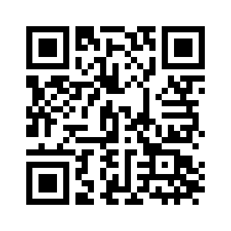
More information
https://github.com/open-voice-interoperability
Generated with AI ∙ March 22, 2024 at 4:18 PM

